Slide 1
Hamiltonian simulation with QSVT on 1D Ising model

Slide 2

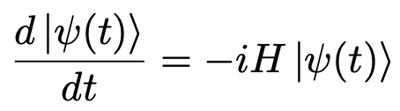

General Idea
Goal: For a given Hamiltonian H, find a unitary U such that for any and t > 0,

Slide 3
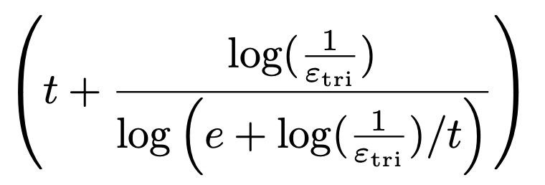

Approximation methods of Hamiltonian Simulation
Trotter-Suzuki simulation
LSU (Linear Combination of Unitaries) simulation
Qubitization simulation
QSVT (Quantum Singular Value Transformation) simulation
Cost:

Slide 4
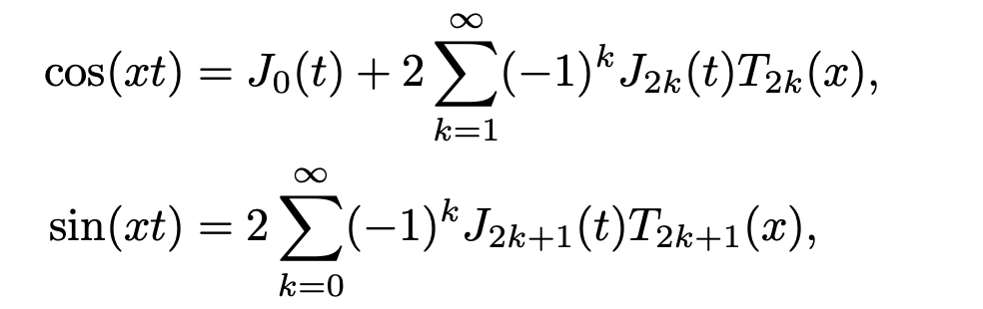

Approximation of Hamiltonian with QSVT

Slide 5
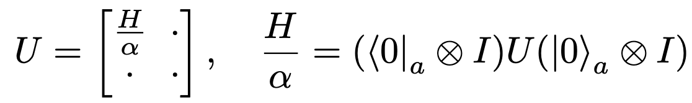



Block encoding

Slide 6
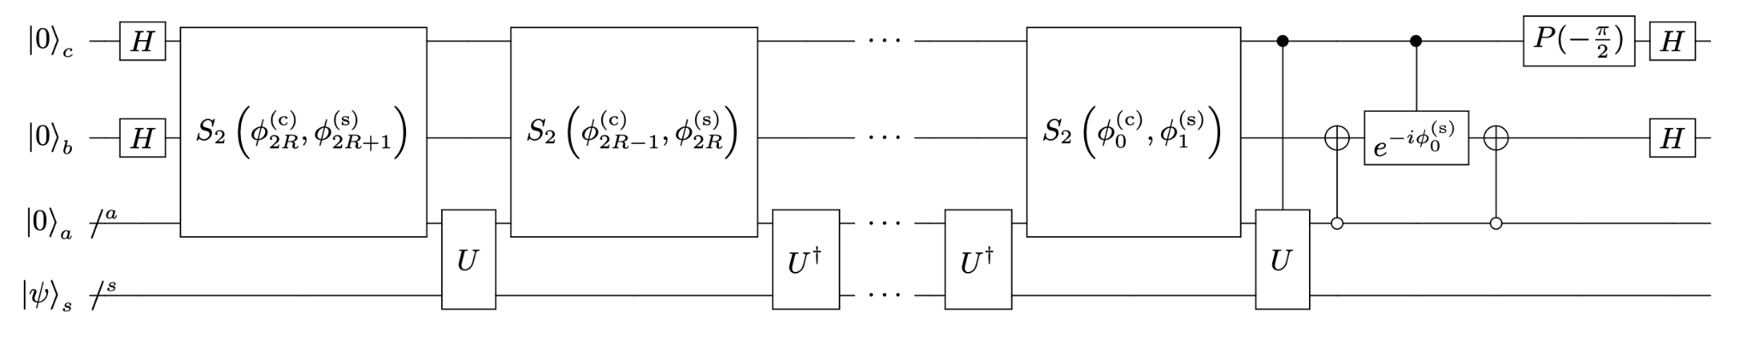
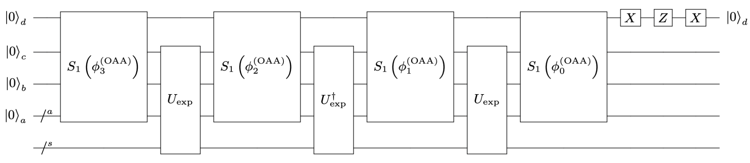

Slide 7
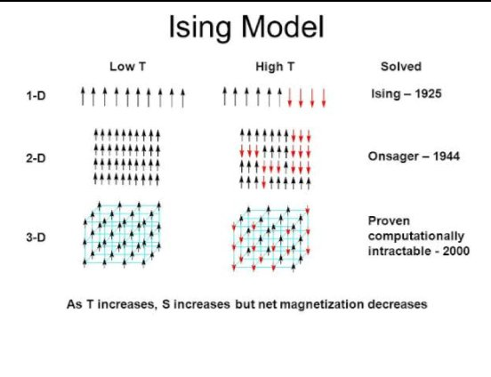

Applications: 1D Ising model

Slide 8
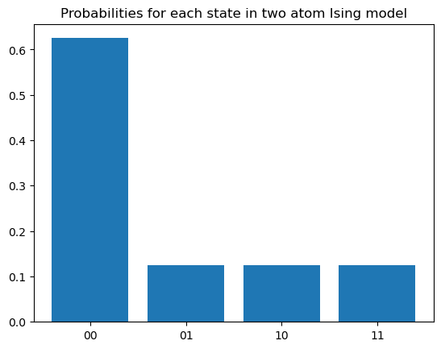
Results
1D Ising model:

